Slide 1
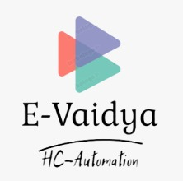
E-Vaidya
The Automation of the functioning of Health Center at IIT Kanpur
By Group 12 - Debuggers

Slide 2

What’s wrong now, that we require something new?

Slide 3

“First Bring your Health Booklet”

Slide 4
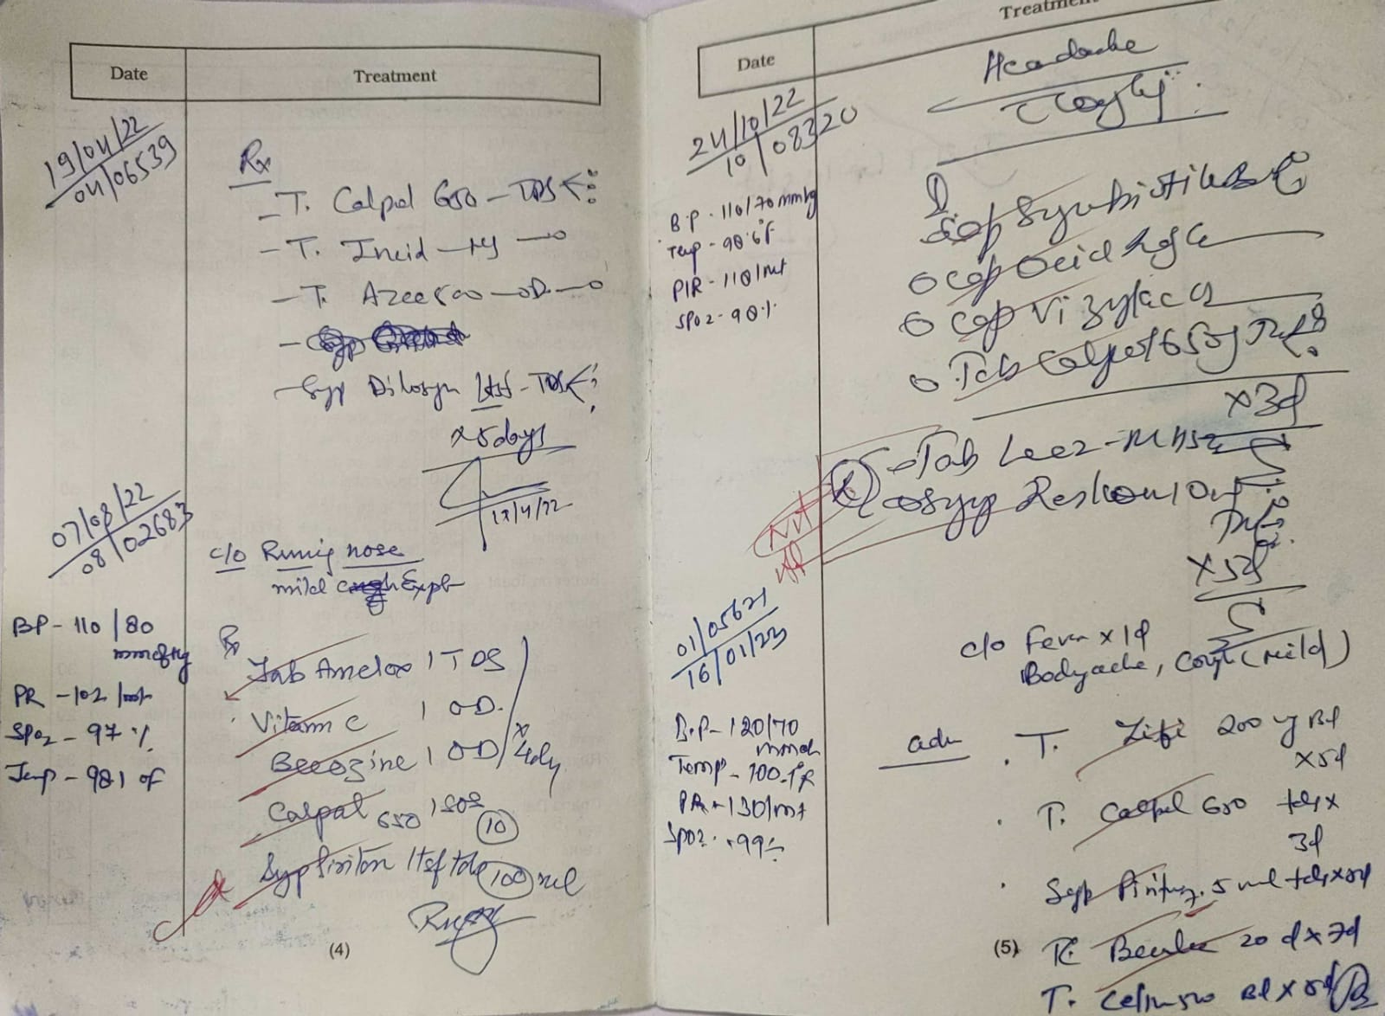

Difficult to trace - Medical History

Slide 5





No one stop solution for all..

Slide 6

What have we transformed it to?

Slide 7
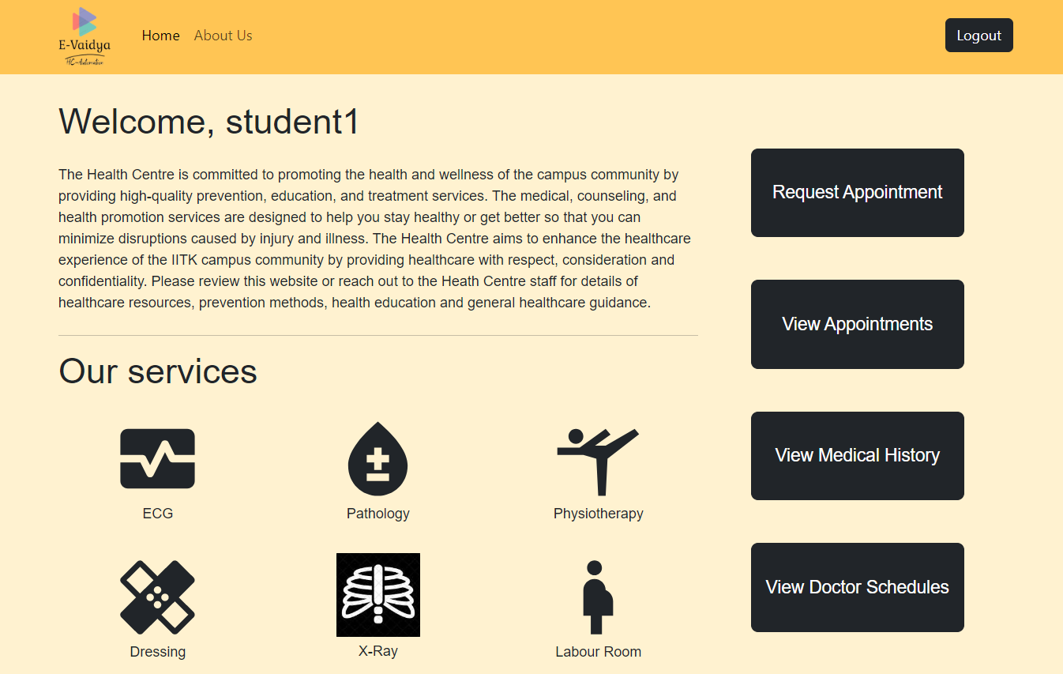

Slide 8
Requirements for Students
View Doctor Schedule
Book an Appointment
View Upcoming Appointments
View Medical History

Slide 9
View My Schedule
01
View Upcoming Appointments
02
Conduct Appointments
03
Requirements for Doctors

Slide 10

Requirements for Nurse
Report patient's vitals like temperature, blood pressure and SpO2

Slide 11

Requirements for Receptionist
Redirecting the Appointment Requests
Set Doctors' schedule
Upload Medical Reports

Slide 12

Requirements for Pharmacist
Dispense medicines while keeping records

Slide 13

Easy to use
Structured and unstructured information can be stored in the same document.

Slide 14

Express is Unopinionated, and we can customize it.
For request handling, we can use Middleware.
A single language is used for frontend and backend development
Express is fast to link it with databases like MySQL, MongoDB, etc.

Slide 15

More resources and support available
Faster than Angular, provide high performance
React has component-based architecture, easier to manage complex UI elements and maintain code

Slide 16


Node.js is fast and efficient, which means it can handle a lot of requests at once without slowing down.
Node.js uses JavaScript, which is a language that many developers already know, making it easy to learn and use.
Node.js has a lot of pre-built modules and libraries that make it easy to add features to your application without having to write all the code yourself.

Slide 17

Software Demo

Slide 18

Future Development Plans

Slide 19

CC Database
19

Slide 20
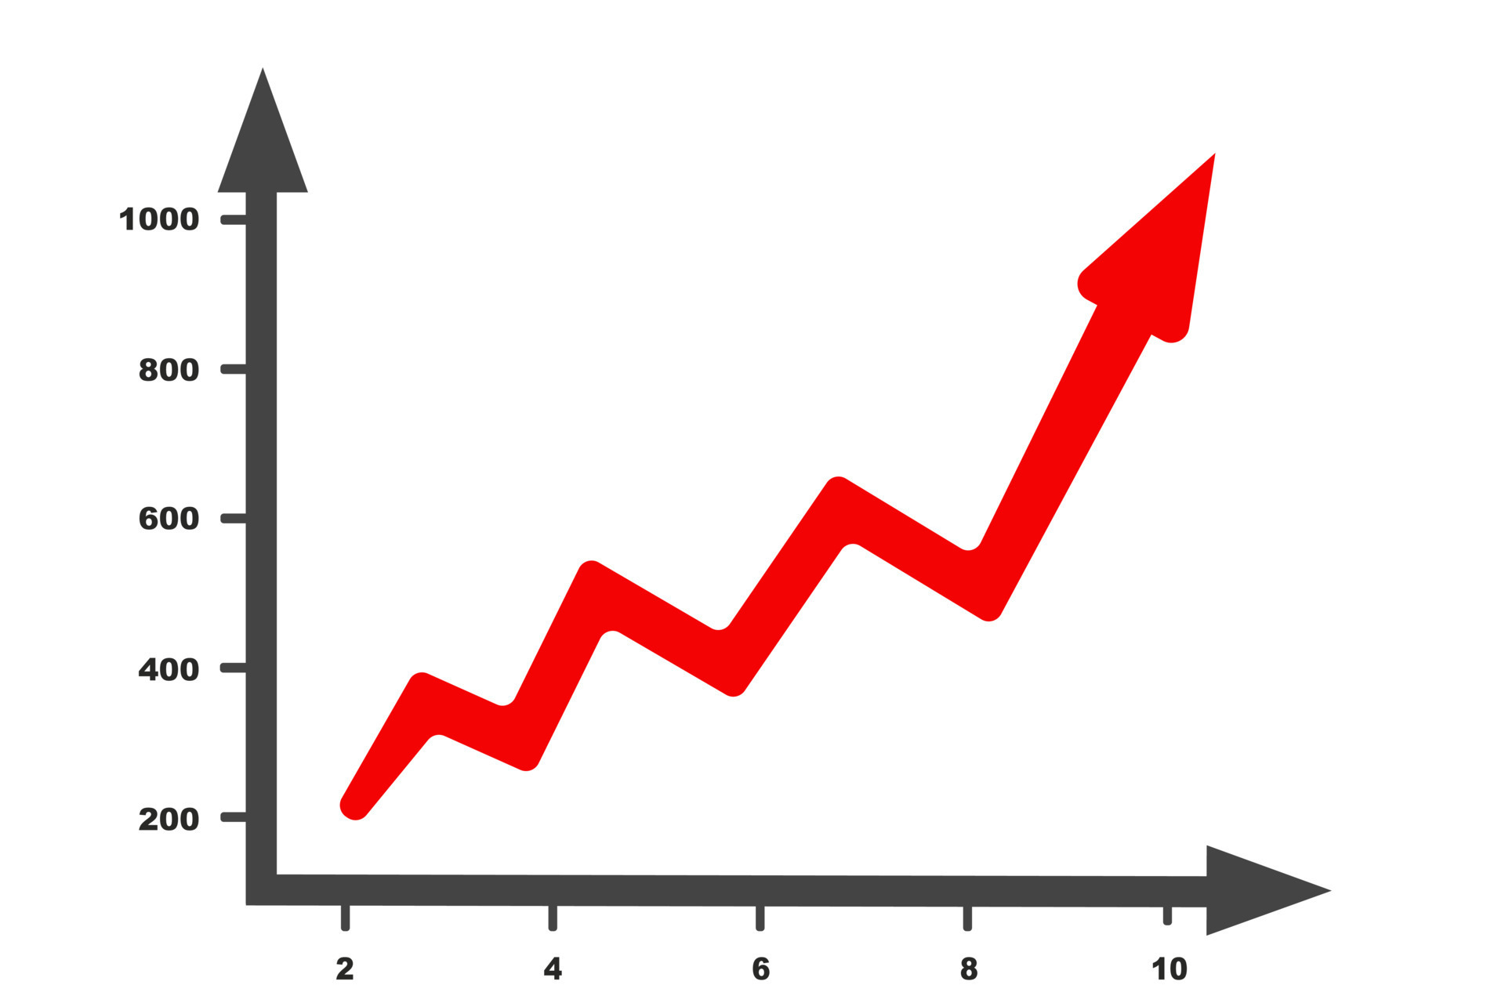
Medical History Trends

Slide 21

Notifications By Mail
Improving General User Features
21

Slide 22

Key Learnings the Project Gave Us

Slide 23

Field Work for Requirements

Slide 24

Use of Detailed Documentation

Slide 25
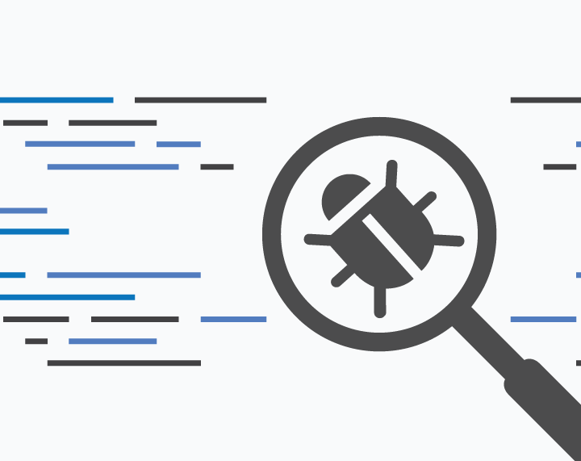
Bug-Free Software ☹

Slide 26
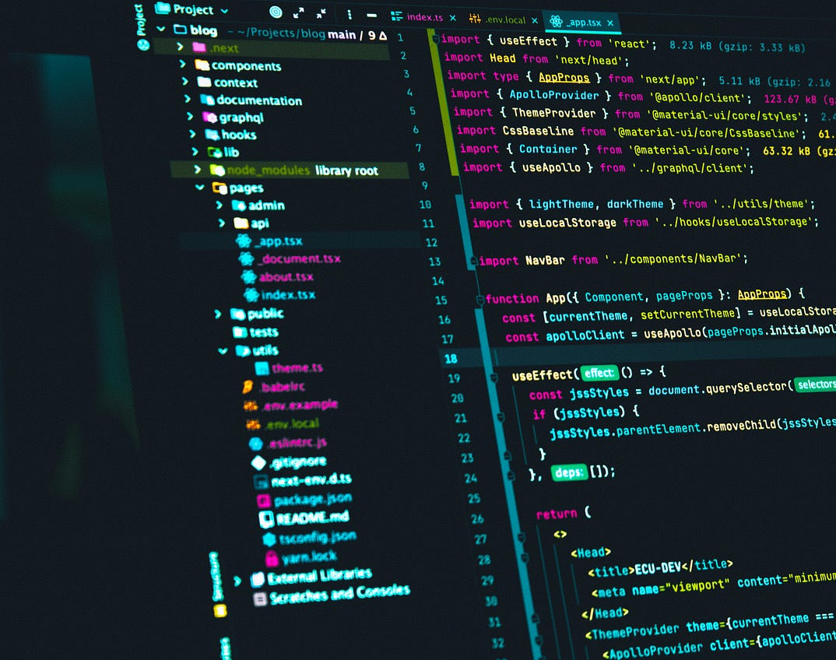
Good Coding Practices

Slide 27

Team

Slide 28


Thank You
The
Debuggers
210104 Aman
210135 Aniket Suhas Borkar
210327 Deven Gangwani
210394 Goutam Das
210496 Kartik Soni
210649 Narendra Singh
210750 Prashant Kumar
210997 Shrey Bansal
210709 Shubham Patel
211090 Swastik Singhal

